Slide 1
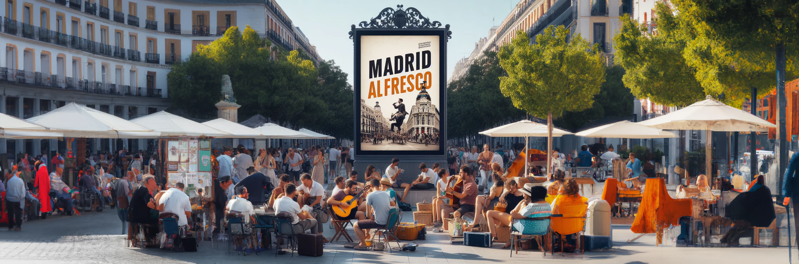



API and RDF: - Definition - Creation
Open Data and Knowledge Graphs
Álvaro Alonso Lancho
Alberto González Ruiz
David García Sanz
Diego Rafael Torrelles Rodríguez

Slide 2


Slide 3
OUR GOAL
Create a guide to terrace locations in Madrid.
Using a map and a location input.

Slide 4
PREPROCESSING
Remove columns that we do not need.
Useless ID's, descriptions or names(like building).
Transformations to number(postal code)
Rename some attributes for obtaining more intuitive names.
→ hora_ini_VS_es to horaApertura.

Slide 5
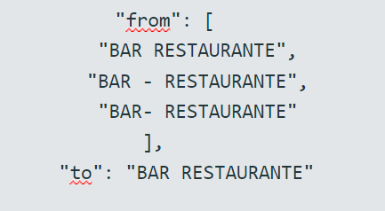
PREPROCESSING
Different text transformations for achieving consistency. Includes removing extra spaces, rearranging words, or eliminating accents.

Slide 6
RECONCILIATION
Using Open Refine we linked with Wikidata.
NombreDistrito to district of Madrid
Barrio to neighborhood of Madrid.
TipoVia by manual reconciliation. CALLE->calle

Slide 7
CREATING URL's
/ : Access resources http://madridalfresco.es/lcc/resource/
#: Access all the data http://madridalfresco.es/lcc/ontology/locales#rotulo

Slide 8
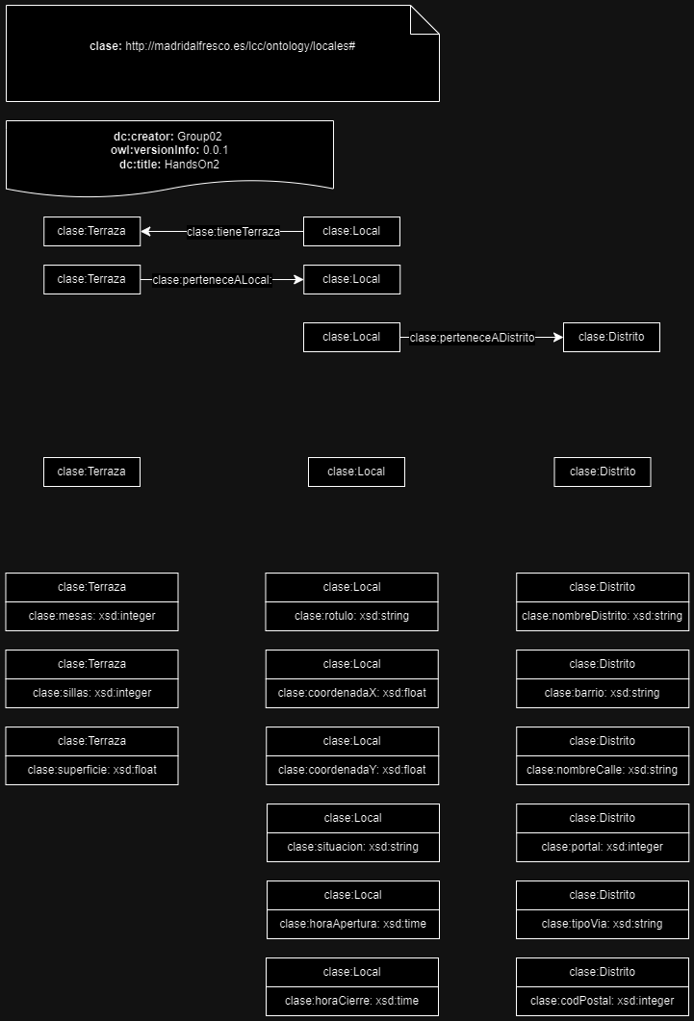
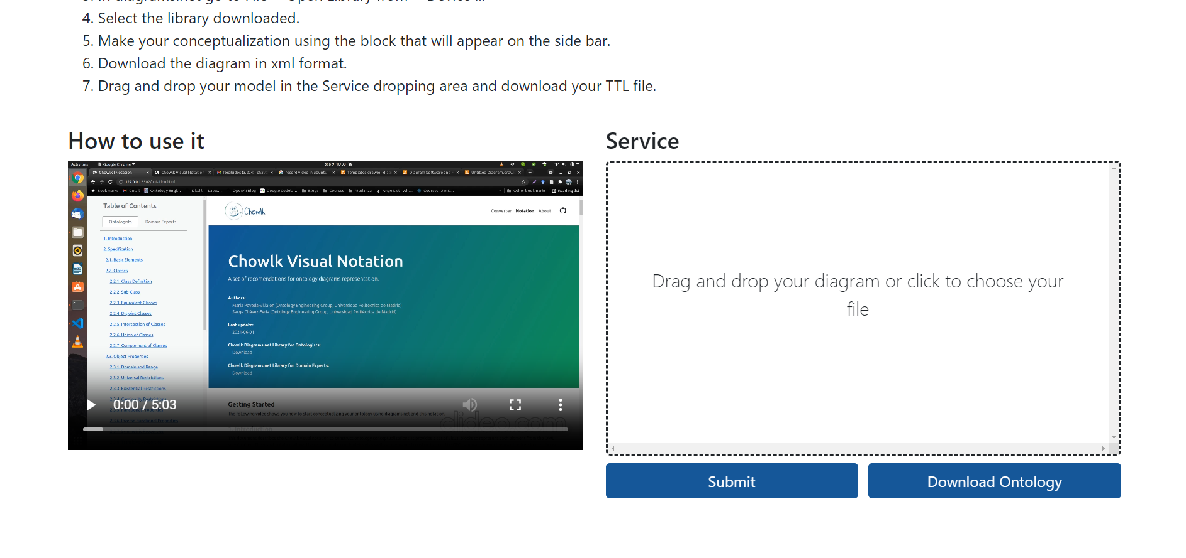
RDF Definition
@prefix clase: <http://madridalfresco.es/lcc/ontology/locales#> .
@prefix dc: <http://purl.org/dc/elements/1.1/> .
@prefix owl: <http://www.w3.org/2002/07/owl#> .
@prefix rdfs: <http://www.w3.org/2000/01/rdf-schema#> .
@prefix xsd: <http://www.w3.org/2001/XMLSchema#> .
clase: a owl:Ontology ;
dc:creator "Group02" ;
dc:description "Ontology code created by Chowlk" ;
dc:title "HandsOn2" ;
owl:versionInfo "0.0.1" .
clase:barrio a owl:DatatypeProperty ;
rdfs:label "barrio" ;
rdfs:domain clase:Distrito ;
rdfs:range xsd:string .
clase:horaApertura a owl:DatatypeProperty ;
rdfs:label "hora apertura" ;
rdfs:domain clase:Local ;
rdfs:range xsd:time .
clase:horaCierre a owl:DatatypeProperty ;
rdfs:label "hora cierre" ;
rdfs:domain clase:Local ;
rdfs:range xsd:time .
clase:mesas a owl:DatatypeProperty ;
rdfs:label "mesas" ;
rdfs:domain clase:Terraza ;
rdfs:range xsd:integer .
clase:perteneceADistrito a owl:ObjectProperty ;
rdfs:label "pertenece a distrito" ;
rdfs:domain clase:Local ;
rdfs:range clase:Distrito .
...MORE PROPERTIES
Ontology : using "https://chowlk.linkeddata.es/" drawio.xml → ontology.ttl

Slide 9
RDF Definition
@prefix clase: <http://madridalfresco.es/lcc/ontology/locales#> .
@prefix rec: <http://madridalfresco.es/lcc/resources/> .
@prefix rdf: <http://www.w3.org/1999/02/22-rdf-syntax-ns#> .
@prefix dc: <http://purl.org/dc/elements/1.1/> .
@prefix owl: <http://www.w3.org/2002/07/owl#> .
@prefix rdfs: <http://www.w3.org/2000/01/rdf-schema#> .
@prefix xsd: <http://www.w3.org/2001/XMLSchema#> .
# Instance Terraza
<rec:Terraza/A7.2_S10_M5_I7>
rdf:type owl:Terraza ;
:numeroMesasAutorizadas "5"^^<http://www.w3.org/2001/XMLSchema#integer> ;
:numeroSillasAutorizadas "10"^^<http://www.w3.org/2001/XMLSchema#integer> ;
:superficie "7.2"^^<http://www.w3.org/2001/XMLSchema#float> ;
:perteneceALocal <rec:Local/SR-X448901Y-4474755> .
# Instance Local
<rec:Local/S_X448901Y_4474755>
rdf:type owl:Local ;
:rotulo "SR" ;
:tieneTerraza "7"^^<http://www.w3.org/2001/XMLSchema#integer> ;
:coordenadaX "448900,55"^^<http://www.w3.org/2001/XMLSchema#float> ;
:coordenadaY "4474755,41"^^<http://www.w3.org/2001/XMLSchema#float> ;
:horaApertura "10:00:00"^^<http://www.w3.org/2001/XMLSchema#time> ;
:horaCierre "00:00:00"^^<http://www.w3.org/2001/XMLSchema#time> ;
:situacion "Abierto" ;
:perteneceADistrito <rec:Distrito/SBC> .
# Instance Distrito
<rec:Distrito/SBC>
rdf:type owl:Distrito;
:nombreDistrito "SAN BLAS-CANILLEJAS " ;
:barrio "ORCASITAS" ;
:tipoVia "PLAZA" ;
:nombreCalle "MIL DELEGADOS" ;
:portal "177"^^<http://www.w3.org/2001/XMLSchema#integer> ;
:codPostal "28022"^^<http://www.w3.org/2001/XMLSchema#integer> .
Ontology : Resources example.

Slide 10


RDF Generation
@prefix rml: <http://semweb.mmlab.be/ns/rml#>.
@prefix ql: <http://semweb.mmlab.be/ns/ql#>.
@prefix rr: <http://www.w3.org/ns/r2rml#>.
@prefix xsd: <http://www.w3.org/2001/XMLSchema#>.
@prefix clase: <http://madridalfresco.es/lcc/ontology/locales#>.
@prefix clase2: <http://madridalfresco.es/lcc/resource/>.
clase2:Local
rml:logicalSource [
rml:source "../csv/terrazas202309.-updated.csv" ;
rml:referenceFormulation ql:CSV
];
rr:subjectMap [
rr:template "http://madridalfresco.es/lcc/resource/Local/{id_local}";
rr:class clase:Local
];
#####datatype properties
rr:predicateObjectMap [
rr:predicate clase:rotulo;
rr:objectMap [
rml:reference "rotulo";
rr:datatype xsd:string
]
];
rr:predicateObjectMap [
rr:predicate clase:coordenadaX;
rr:objectMap [
rml:reference "coordenadaX";
rr:datatype xsd:float
]
#####object properties
rr:predicateObjectMap [
rr:predicate clase:tieneTerraza;
rr:objectMap [
rr:template "http://madridalfresco.es/lcc/resource/Terraza/{id_terraza}";
]
];
2. Mapping rules: rules.yml → rules.rml
Command: yarrrml-parser -i rules.yml -o rules.rml
prefixes:
clase2: "http://madridalfresco.es/lcc/resource/"
clase: "http://madridalfresco.es/lcc/ontology/locales#"
mappings:
Local:
sources:
- ['../csv/terrazas202309-updated-csv-with-links.csv~csv']
s: http://madridalfresco.es/lcc/resource/Local/$(id_local)
po:
- [a, clase2:Local]
- [clase:rotulo, $(rotulo)]
- [clase:coordenadaX, $(coordenadaX)]
- [clase:coordenadaY, $(coordenadaY)]
- [clase:situacion, $(situacion)]
- [clase:horaApertura, $(horaApertura)]
- [clase:horaCierre, $(horaCierre)]
- [clase:tieneTerraza, "http://madridalfresco.es/lcc/resource/Terraza/$(id_terraza)"]
- [clase:perteneceADistrito, "http://madridalfresco.es/lcc/resource/Distrito/$(id_distrito)"]
...

Slide 11


RDF Generation
http://madridalfresco.es/lcc/resource/Local/S_X448901_Y4474755> <http://www.w3.org/1999/02/22-rdf-syntax-ns#type> <http://madridalfresco.es/lcc/ontology/locales#Local>.
<http://madridalfresco.es/lcc/resource/Local/S_X448901_Y4474755> <http://madridalfresco.es/lcc/ontology/locales#horaApertura> "08:00:00"^^<http://www.w3.org/2001/XMLSchema#time>.
<http://madridalfresco.es/lcc/resource/Local/S_X448901_Y4474755> <http://madridalfresco.es/lcc/ontology/locales#horaCierre> "01:30:00"^^<http://www.w3.org/2001/XMLSchema#time>.
<http://madridalfresco.es/lcc/resource/Local/S_X448901_Y4474755> <http://madridalfresco.es/lcc/ontology/locales#tieneTerraza> <http://madridalfresco.es/lcc/resource/Terraza/A7.2_S10_M5_I7>.
<http://madridalfresco.es/lcc/resource/Local/S_X448901_Y4474755> <http://madridalfresco.es/lcc/ontology/locales#perteneceADistrito> <http://madridalfresco.es/lcc/resource/Distrito/SAN-BLA-CAN>.
<http://madridalfresco.es/lcc/resource/Local/S_X448901_Y4474755> <http://madridalfresco.es/lcc/ontology/locales#rotulo> "SR".
<http://madridalfresco.es/lcc/resource/Local/S_X448901_Y4474755> <http://madridalfresco.es/lcc/ontology/locales#coordenadaX> "448900.55"^^<http://www.w3.org/2001/XMLSchema#float>.
<http://madridalfresco.es/lcc/resource/Local/S_X448901_Y4474755> <http://madridalfresco.es/lcc/ontology/locales#coordenadaY> "4474755.41"^^<http://www.w3.org/2001/XMLSchema#float>.
<http://madridalfresco.es/lcc/resource/Local/S_X448901_Y4474755> <http://madridalfresco.es/lcc/ontology/locales#situacion> "Abierto".
<http://madridalfresco.es/lcc/resource/Local/H_X442587_Y4476525> <http://www.w3.org/1999/02/22-rdf-syntax-ns#type> <http://madridalfresco.es/lcc/ontology/locales#Local>.
<http://madridalfresco.es/lcc/resource/Local/H_X442587_Y4476525> <http://madridalfresco.es/lcc/ontology/locales#horaApertura> "10:00:00"^^<http://www.w3.org/2001/XMLSchema#time>.
<http://madridalfresco.es/lcc/resource/Local/H_X442587_Y4476525> <http://madridalfresco.es/lcc/ontology/locales#horaCierre> "02:30:00"^^<http://www.w3.org/2001/XMLSchema#time>.
<http://madridalfresco.es/lcc/resource/Local/H_X442587_Y4476525> <http://madridalfresco.es/lcc/ontology/locales#tieneTerraza> <http://madridalfresco.es/lcc/resource/Terraza/A21.06_S27_M9_I33>.
<http://madridalfresco.es/lcc/resource/Local/H_X442587_Y4476525> <http://madridalfresco.es/lcc/ontology/locales#perteneceADistrito> ...
2. RDF File: rules.rml + updated.csv → rdf.ttl
Command: java -jar .\rmlmapper-6.2.2-r371-all.jar -m .\rules.rml -o ..\rdf\rdf_with_rules.ttl
@prefix rml: <http://semweb.mmlab.be/ns/rml#>.
@prefix ql: <http://semweb.mmlab.be/ns/ql#>.
@prefix rr: <http://www.w3.org/ns/r2rml#>.
@prefix xsd: <http://www.w3.org/2001/XMLSchema#>.
@prefix clase: <http://madridalfresco.es/lcc/ontology/locales#>.
@prefix clase2: <http://madridalfresco.es/lcc/resource/>.
clase2:Local
rml:logicalSource [
rml:source "../csv/terrazas202309.-updated.csv" ;
rml:referenceFormulation ql:CSV
];
rr:subjectMap [
rr:template "http://madridalfresco.es/lcc/resource/Local/{id_local}";
rr:class clase:Local
];
+
id_terraza,id_local,id_distrito,nombreDistrito,barrio,tipoVia,nombreCalle,portal,codPostal,coordenadaX,coordenadaY,situacion,rotulo,superficie,horaApertura,horaCierre,mesas,sillas
A7.2_S10_M5_I7,S_X448901_Y4474755,SAN-BLA-CAN,SAN BLAS - CANILLEJAS,ROSAS,CALLE,SOFIA,177,28022,448900.55,4474755.41,Abierto,SR,7.2,08:00:00,01:30:00,5,10
A21.06_S27_M9_I33,H_X442587_Y4476525,SAL,SALAMANCA,GUINDALERA,AVENIDA,AMERICA,2,28028,442586.58,4476524.51,Abierto,HONTANARES,21.06,10:00:00,02:30:00,9,27
A11.16_S14_M4_I34,BML_X442987_Y4476380,SAL,SALAMANCA,GUINDALERA,CALLE,ALONSO HEREDIA,25,28028,442986.58,4476379.5,Abierto,BAR MARISQUERIA LUIS,11.16,10:00:00,02:30:00,4,14

Slide 12
RDF Generation
New csv with wikidata reconciliation + New mapping with links (sameAs predicates) → New RDF
rr:predicateObjectMap [
rr:predicate clase:sameAsNombreDistrito;
rr:objectMap [
rml:reference "same_as_wikidata_nombreDistrito";
rr:datatype xsd:string
]
];
rr:predicateObjectMap [
rr:predicate clase:sameAsBarrio;
rr:objectMap [
rml:reference "same_as_wikidata_barrio";
rr:datatype xsd:string
]
];
rr:predicateObjectMap [
rr:predicate clase:sameAsTipoVia;
rr:objectMap [
rml:reference "same_as_wikidata_tipoVia";
rr:datatype xsd:string
]
].
id_terraza,id_local,id_distrito,nombreDistrito,same_as_wikidata_nombreDistrito,barrio,same_as_wikidata_barrio,tipoVia,same_as_wikidata_tipoVia,nombreCalle,portal,codPostal,coordenadaX,coordenadaY,situacion,rotulo,superficie,horaApertura,horaCierre,mesas,sillas
A7.2_S10_M5_I7,S_X448901_Y4474755,SAN-BLA-CAN,San Blas-Canillejas,https://wikidata.org/entity/Q2001937,Rosas,https://wikidata.org/entity/Q18880469,calle,https://wikidata.org/entity/Q79007,SOFIA,177,28022,448900.55,4474755.41,Abierto,SR,7.2,08:00:00,01:30:00,5,10
+
<http://madridalfresco.es/lcc/resource/Distrito/SAN-BLA-CAN> <http://madridalfresco.es/lcc/ontology/locales#sameAsNombreDistrito> "https://wikidata.org/entity/Q2001937".
<http://madridalfresco.es/lcc/resource/Distrito/SAN-BLA-CAN> <http://madridalfresco.es/lcc/ontology/locales#sameAsBarrio> "https://wikidata.org/entity/Q18880469".
<http://madridalfresco.es/lcc/resource/Distrito/SAN-BLA-CAN> <http://madridalfresco.es/lcc/ontology/locales#sameAsTipoVia> "https://wikidata.org/entity/Q79007".

Slide 13


RDF Validation
<http://madridalfresco.es/lcc/resource/Distrito/USERA> <http://vocab.linkeddata.es/datosabiertos/def/sector-publico/territorio#barrio> "Moscardó".
<http://madridalfresco.es/lcc/resource/Distrito/USERA> <http://vocab.linkeddata.es/datosabiertos/def/sector-publico/territorio#tipoVia> "calle".
<http://madridalfresco.es/lcc/resource/Distrito/USERA> <http://vocab.linkeddata.es/datosabiertos/def/urbanismo-infraestructuras/callejero#via> "ANTONIO LOPEZ".
<http://madridalfresco.es/lcc/resource/Distrito/USERA> <http://vocab.linkeddata.es/datosabiertos/def/urbanismo-infraestructuras/callejero#portal> "152"^^<http://www.w3.org/2001/XMLSchema#integer>.
<http://madridalfresco.es/lcc/resource/Distrito/USERA> <http://www.geonames.org/ontology#postalCode> "28026"^^<http://www.w3.org/2001/XMLSchema#integer>.
4. Ontology updated (reused) → shapes.ttl
Shapes.ttl + final_rdf.ttl → report.ttl → Final Fix
@prefix rdf: <http://www.w3.org/1999/02/22-rdf-syntax-ns#> .
@prefix sh: <http://www.w3.org/ns/shacl#> .
@prefix owl: <http://www.w3.org/2002/07/owl#> .
@prefix afn: <http://jena.apache.org/ARQ/function#> .
@prefix xsd: <http://www.w3.org/2001/XMLSchema#> .
@prefix rdfs: <http://www.w3.org/2000/01/rdf-schema#> .
@prefix dc: <http://purl.org/dc/elements/1.1/> .
@prefix clase: <http://madridalfresco.es/lcc/ontology/locales#> .
<https://astrea.linkeddata.es/shapes#7819c31131d7966d181e98eae1d5a687>
a sh:PropertyShape ;
rdfs:label "portal" ;
sh:datatype xsd:integer ;
sh:name "portal" ;
sh:nodeKind sh:Literal ;
sh:path clase:portal ;
sh:pattern "[\\-+]?[0-9]+" .
<https://astrea.linkeddata.es/shapes#7811160f99f5ee392917ebddd1409d95>
a sh:PropertyShape ;
rdfs:label "coordenada y" ;
sh:datatype xsd:float ;
sh:name "coordenada y" ;
sh:nodeKind sh:Literal ;
sh:path clase:coordenadaY ;
sh:pattern "(\\+|-)?([0-9]+(\\.[0-9]*)?|\\.[0-9]+)([Ee](\\+|-)?[0-9]+)?|(\\+|-)?INF|NaN" .
+
a sh:ValidationReport ;
sh:conforms false ;
sh:result [ a sh:ValidationResult ;
sh:focusNode "249"^^<http://www.w3.org/2001/XMLSchema#int> ;
sh:message "Node \"249\"^^<http://www.w3.org/2001/XMLSchema#int> doesn't have dataType <http://www.w3.org/2001/XMLSchema#integer>" ;
sh:resultPath <http://madridalfresco.es/lcc/ontology/locales#portal> ;
sh:resultSeverity sh:Violation ;
sh:sourceConstraintComponent sh:DatatypeConstraintComponent ;
sh:sourceShape <https://astrea.linkeddata.es/shapes#7819c31131d7966d181e98eae1d5a687>
@prefix sh: <http://www.w3.org/ns/shacl#> .
[ a sh:ValidationReport ;
sh:conforms true
] .

Slide 14
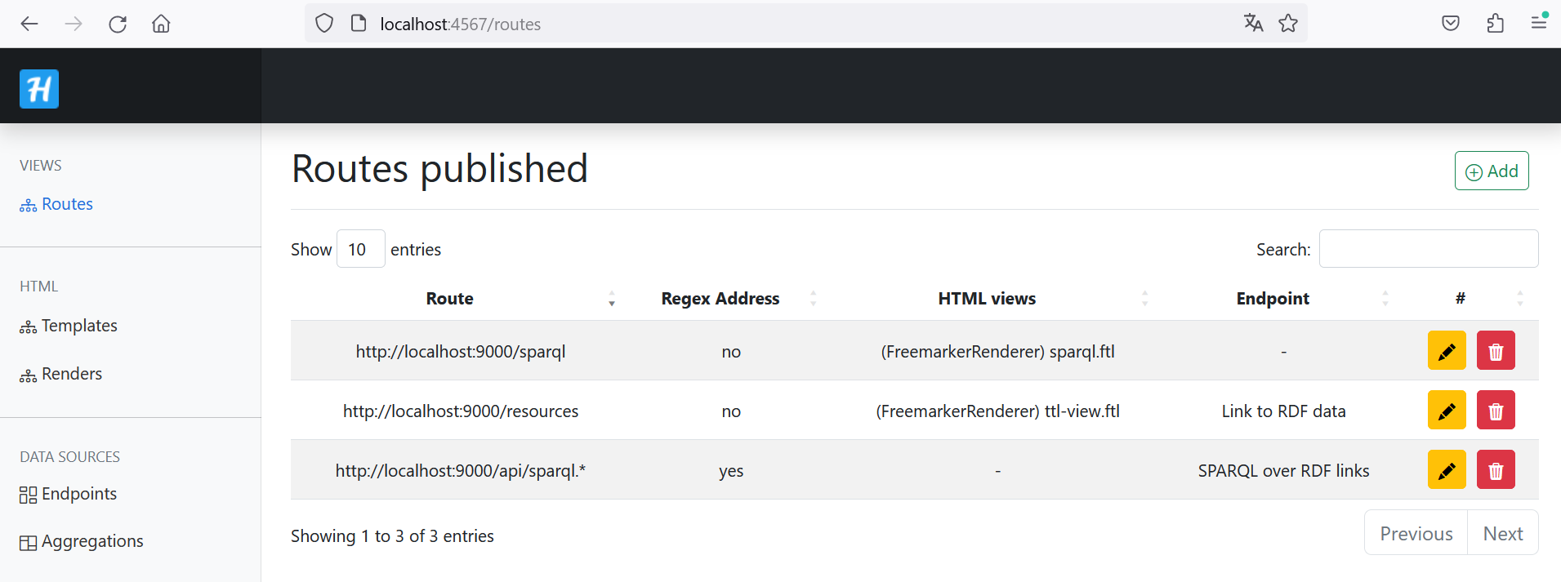
Back-End
Making queries for the RDF in Helios:

Slide 15
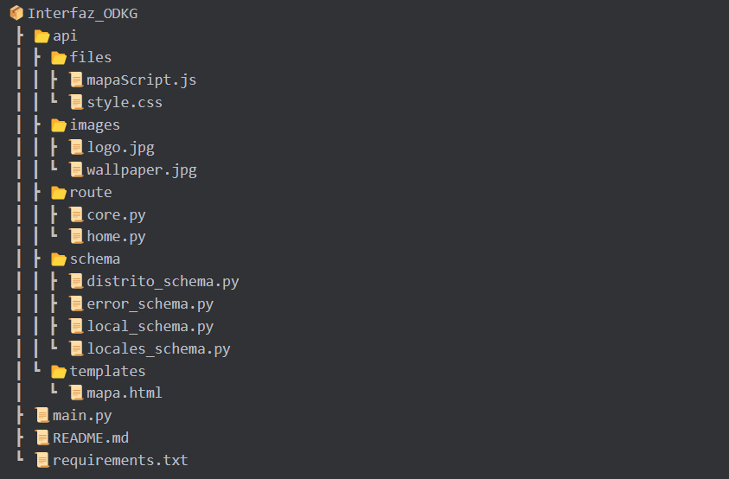
Back-End
For the API implementation:
Python
Flask
Swagger (documentation)

Slide 16
Back-End
API documentation:
http://127.0.0.1:5000/apidocs/ (swagger documentation)
http://127.0.0.1:5000/ (front-end)
http://127.0.0.1:5000/api/search/distrito/{filtro} (finding districts)
http://127.0.0.1:5000/api/search/distrito/{filtro}/locales (Get information about every local on a district)

Slide 17

Front-End
The Front-End is made up of two big components
Mapa.html
Style.css
MapaScript.js

Slide 18
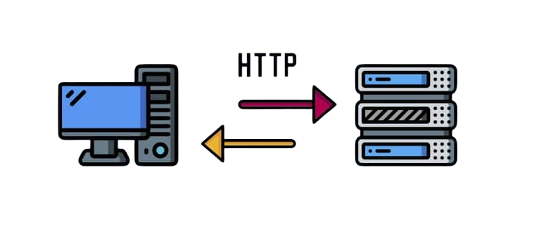
MapaScript.js
Map Initialization
Server request
AutoComplete
Error Handling

Slide 19
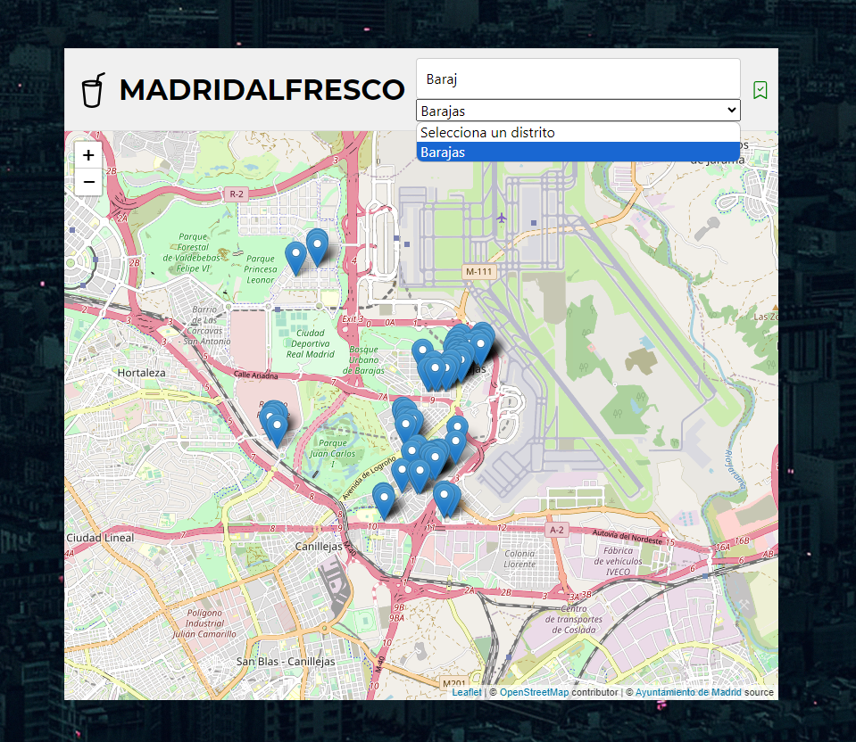
Mapa.html
Headers
Search Bar
Styles

